Slide 1

Exhibition Database Management System
Rahul Bothra Yu-Chen Huang Rahul Manohar Durshinapally Zijian Feng Om Ashok Dhinoja
Project For DAMG6210 - Data Management and
Database Design
Under the guidance of Manuel D Montrond

Slide 2

Objectives
To present the design and implementation of a centralized database system for the Electronic Entertainment Expo, aimed at efficiently managing exhibitor data, audience information, ticket sales, and event scheduling. The objective is to demonstrate how this system eliminates data redundancy, ensures consistency, enhances communication among exhibitors, audience, staff, and performers, and facilitates quick access to critical event information, providing a seamless experience for all stakeholders.

Slide 3
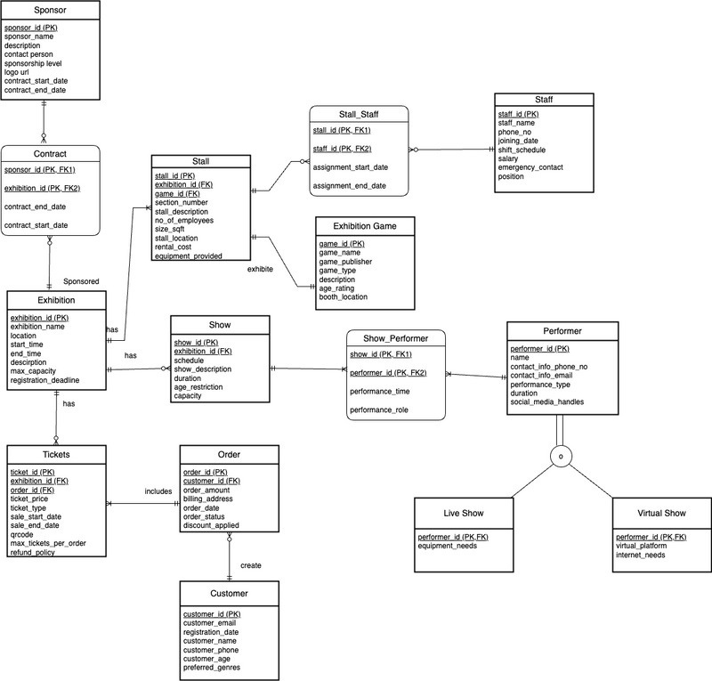
Entity Relationship Diagram

Slide 4
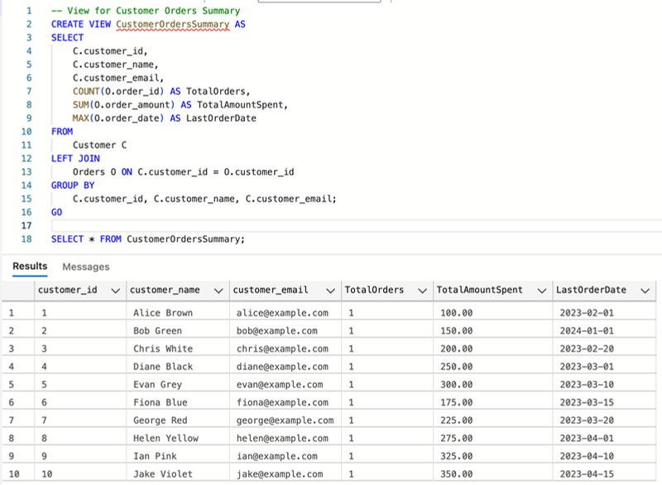
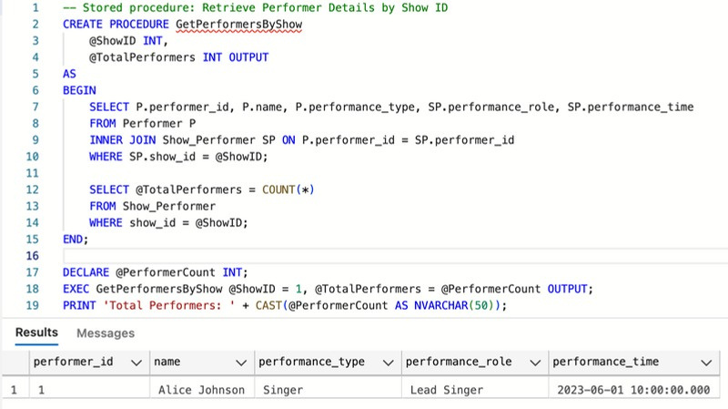
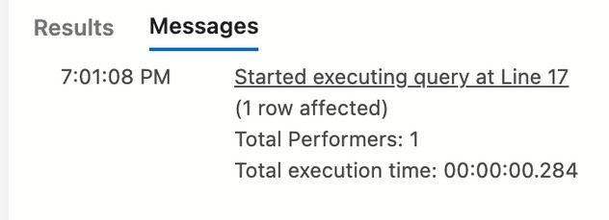
Views
Stored Procedures
The CustomerOrdersSummary view consolidates customer order data,
The GetPerformersByShow stored procedure retrieves performer details for a specific show and outputs the total number of performers.
showing total orders, total spending, and the last order date for each customer.

Slide 5
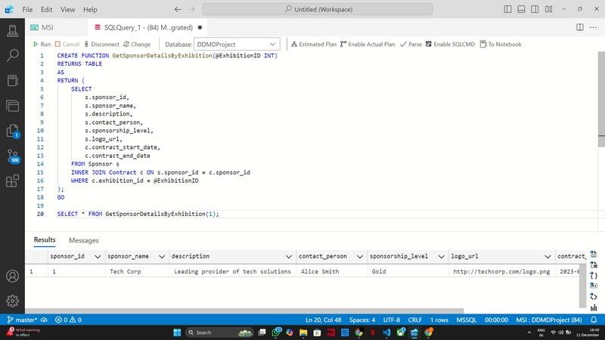
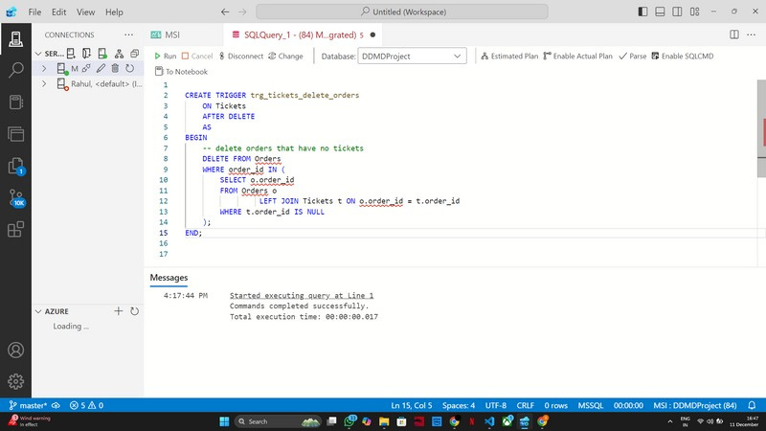
UDFs and Triggers
Developed a SQL function GetSponsorDetailsByExhibition that efficiently fetches sponsor details such as name, description, and contact information, filtered by exhibition ID to enhance event management and reporting.
Created a SQL trigger trg_tickets_delete_orders on the Tickets table to automatically delete orphaned orders that no longer have associated tickets, ensuring database integrity and preventing data redundancy.

Slide 6
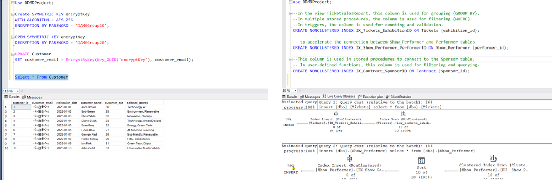
Data Encryption
Non Clustered Index
The script creates non-clustered indexes on specific columns in the Tickets, Show_Performer, and Contract tables to improve query performance by speeding up data filtering, grouping, and joining operations.
The script implements AES-256 encryption with a symmetric key in SQL Server to secure customer email data, ensuring confidentiality and protection

Slide 7
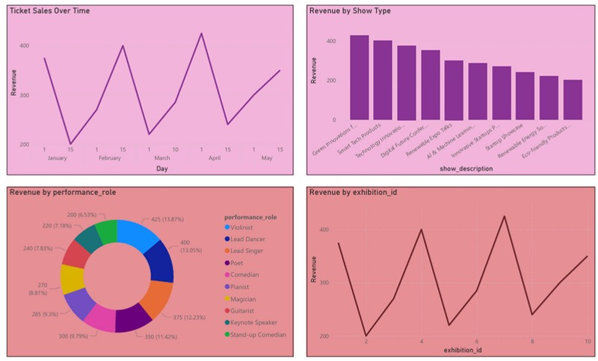
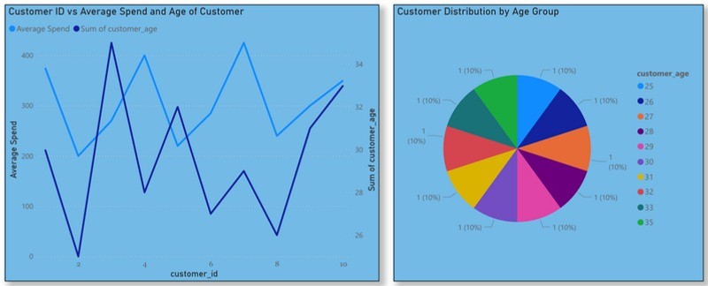
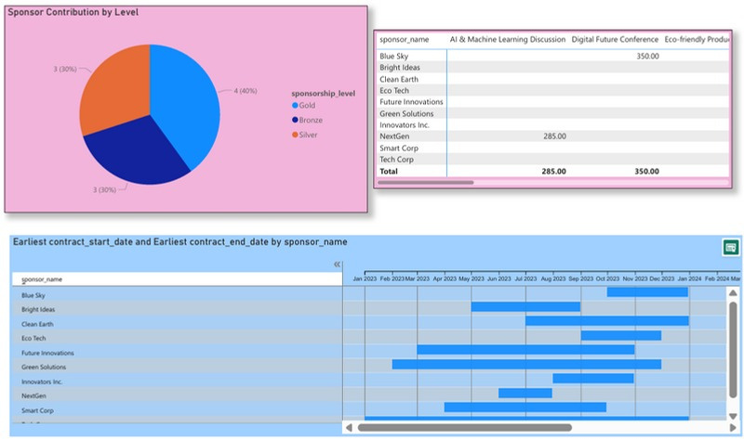
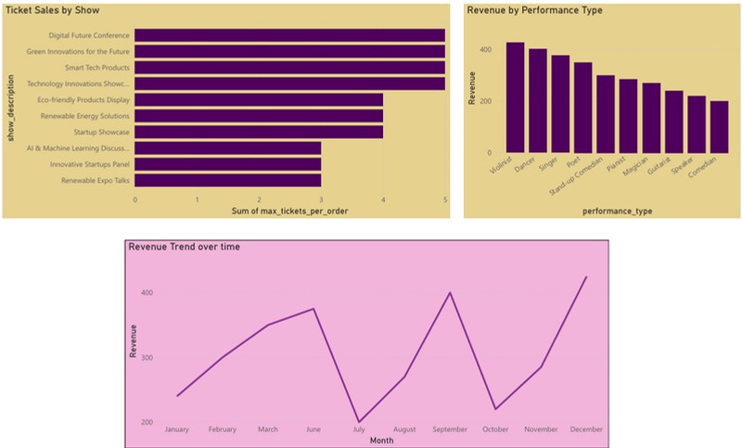
Dasboard

Slide 8

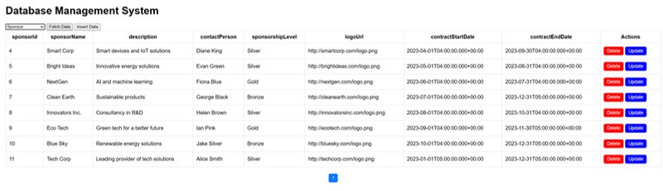
GUI
We have created a GUI for the program, allowing users to perform CRUD operations (Create, Read, Update, Delete). We use Spring Boot as the backend and HTML with JavaScript as the front end to implement these operations.

